Slide 1



Diffuser-Assisted Photometry of Transiting Exoplanets
Justin Klingele, AZSGC Intern
Dr. Kevin Hardegree-Ullman, Steward Observatory
Partner

Slide 2


Introduction to Transit Photometry
In around 1% of systems, exoplanets cross in front of their parent stars from our perspective on Earth.
The technique of analyzing a star's brightness vs time is photometry.
When applied to exoplanets we call this transit photometry.
The plot of brightness versus time is called a light curve.
Star
Brightness
Time

Slide 3
What is a diffuser? What does it do?
Diffusers spread incoming light over many camera pixels.
The shape incoming light makes on a camera detector is called its point spread function (PSF).
No Diffuser
Camera
Narrow PSF
Signal
Diffuser
Camera
Broad PSF
Pixels
Signal
Pixels

Slide 4
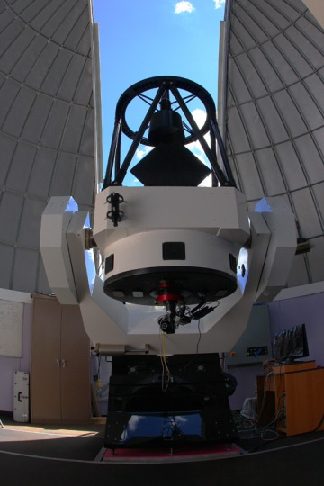
Q: Does a diffuser improve precision on small telescopes?
Diffusers improve precision for large telescopes and bright targets. (Stefánsson, 2017)
We wanted to apply this technique to smaller telescopes, such as the 32” Schulman telescope on Mt. Lemmon.
Goal is to test application of diffusers for the Exoplanet Discovery and Exploration Network (EDEN) Project.
Image Source: Mt. Lemmon Skycenter

Slide 5
Objectives
Determine whether use of engineered diffuser successfully increases transit photometry precision.
Create a Python program to optimize filter, diffuser, and telescope combinations.
Test diffuser-assisted photometry on 32” Schulman telescope.
Future
Incorporate my diffuser code into EDEN system to predict whether a diffuser would be useful for a particular target.

Slide 6
Methods
Wrote code that would optimize a diffuser system for the 32” Schulman telescope.
Conducted several observation runs using a diffuser system.
Alternated between diffused and non-diffused modes, producing two light curves per observing run to test diffuser performance.
Performed photometric analysis using the EDEN image processing program.

Slide 7
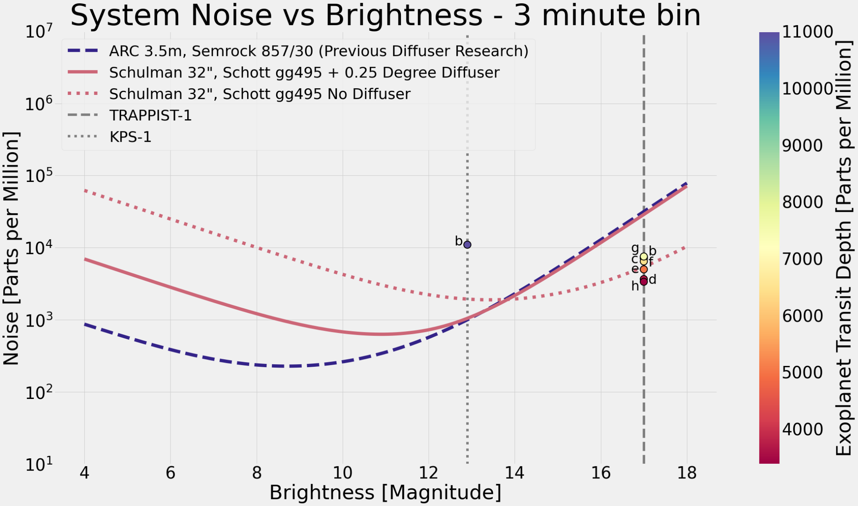
Results
Note: ARC 3.5m used as reference.
Brighter : Fainter

Slide 8
Results
Brighter than magnitude 14, Schott gg495 filter offers improved precision with diffuser.
Suggests observing with diffuser for targets brighter than magnitude 14 and transit depth >1000 parts per million.

Slide 9
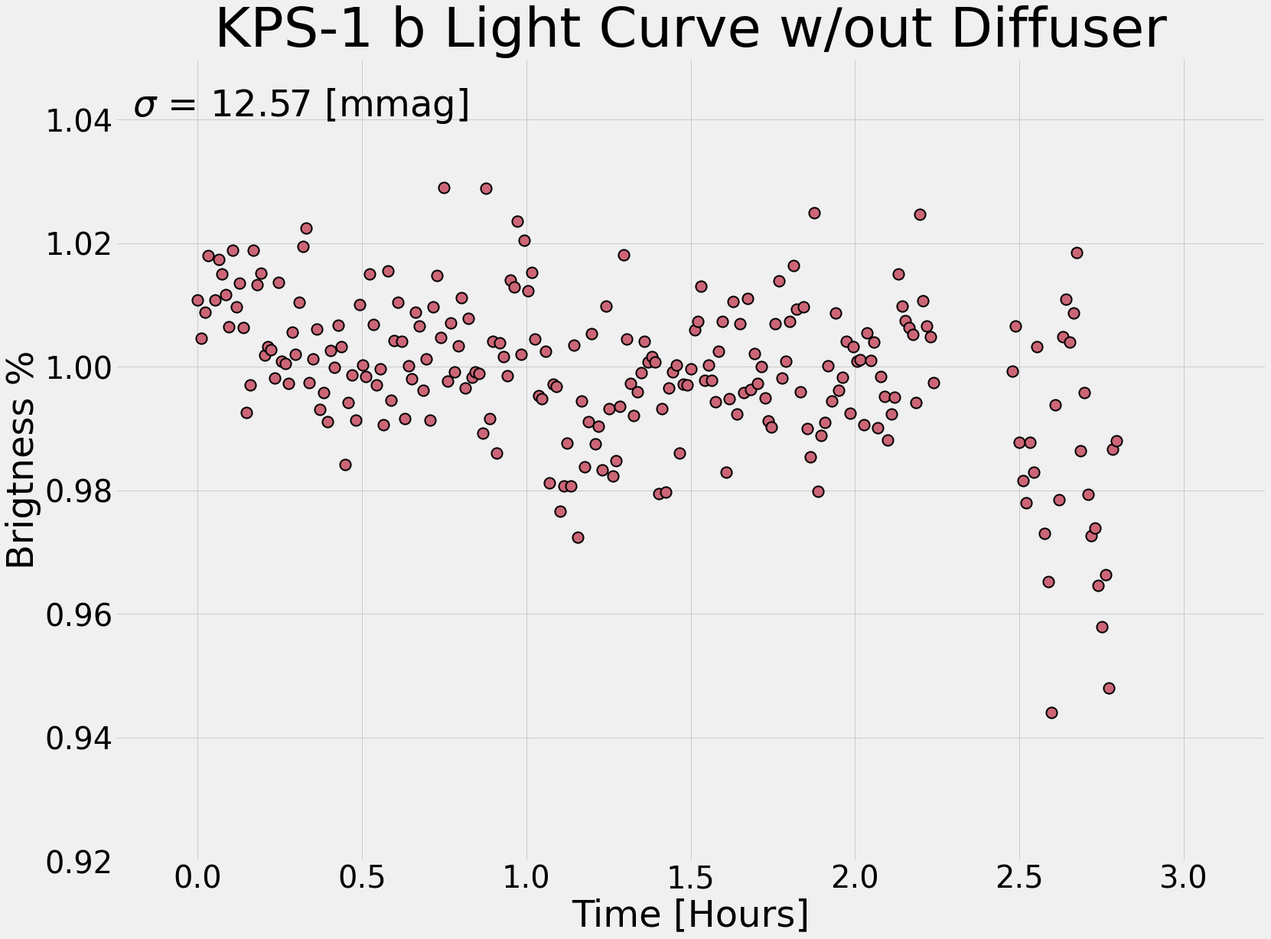
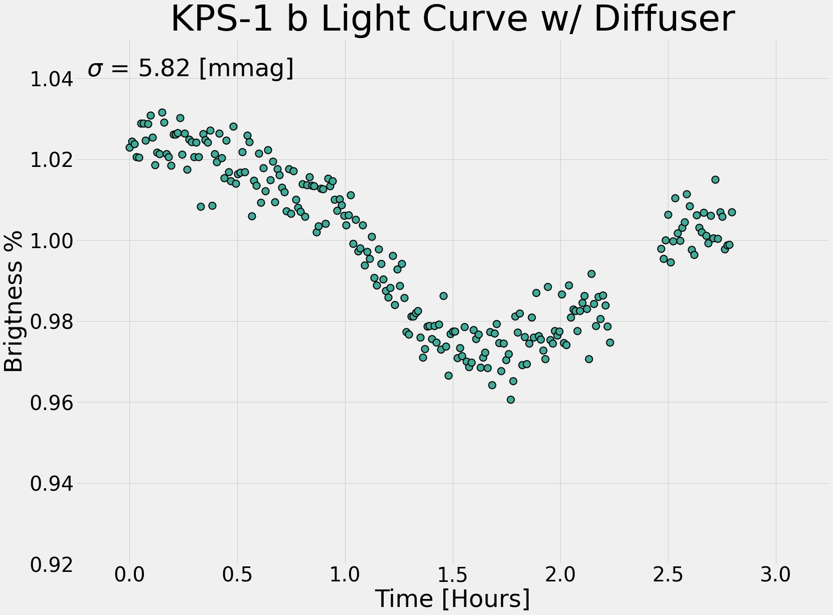
Diffuser reduced datapoint scatter by nearly 50%!

Slide 10
Interpretation of Results
Diffuser system improves precision on this relatively small telescope.
Observational results support theoretical predictions.
Improvement in precision depends on target brightness and filter choice.
Pre-observation planning should check target brightness and telescope setup to decide on use of diffuser-assisted photometry.

Slide 11
Acknowledgements
Thanks to
Dr. Kevin Hardegree-Ullman, Project Advisor
Mt. Lemmon SkyCenter
Travis Deyoe, Observatory Scheduling and Operations
Dr. Gudmundur Stefánsson, Technical Advising
EDEN Team
Jeremy Dietrich, Data Processing
Dr. Daniel Apai, Team Lead
The University of Arizona Department of Astronomy and Steward Observatory
Arizona Space Grant Consortium

Slide 12
Thank You

